Slide 1


A Brief of Other
Error Correction Codes
Group 5

Slide 2

Our Team
Siang Yew
Yen Theng
Mervin
Andres
Amrin
Raynard
202169990243
202169990121
202169990116
202169990266
202169990046
202169990298

Slide 3



Content
1 | 2 | 3 | 4 | 5 | 6 | 7 | 8
SiangYew | YenTheng | Amrin | Mervin | Andres | Raynard | SiangYew | Everyone
Introduction | Reed Solomon | Network Coding | BCH Codes | Fountain Codes | Turbo Codes | Conclusion | Q&A

Slide 4


Introduction
Kong Siang Yew 202169990243

Slide 5
How can it be?
Why there is no error during data trasmission ?
How can it transmit information so accurately and reliably ?

Slide 6
Reliable data transmission is critical for modern communications
Noise and interference causes errors during transmission
What is Error Correction Codes?
Error correction codes add redundancy to detect and correct errors

Slide 7
Reed
Solomon
Tan Yen Theng 202169990121

Slide 8

Understanding of Reed-Solomon
recover lost or corrupted data
powerful tool for ensuring data integrity
How does it work?

Slide 9
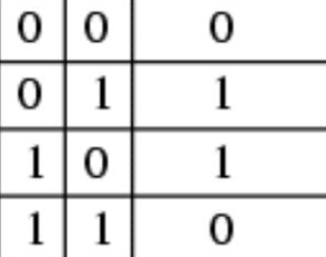
Easy! Just...
algebraic principles: FINITE FIELDS
encode data into codeword with redundant information (symbols)
decoder correct errors by the symbols
Note that:
size of codeword
+
degree of the generator polynomial
=
number of errors that can be corrected
XOR
logic operations
(addition in FINITE FIELDS )

Slide 10
Applications
Data Storage
Data Transmission
CDs/DVDs
Digital Broadcasting
Space Communication

Slide 11
Network Coding
Amrin Paudel 202169990046

Slide 12
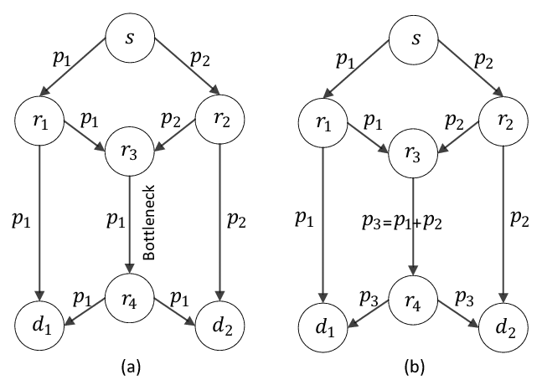
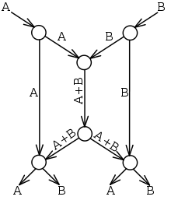
What is Network Coding?
Encoding data before transmission and decoding it upon receipt.
They are performed to make networks work faster, more efficiently, and hassle-free.
Wireless Network
Wired Network

Slide 13


Network Coding For
Its Types
Network coding is helpful in wireless mesh, messaging, storage, multicast streaming, file-sharing peer-to-peer (P2P), and other networks where the same data needs to be sent to multiple destinations.
Random Network Coding
Vector Network Coding
Linear Network Coding

Slide 14

Working Principles
1
Encoding at Intermediate Nodes
2
Efficient Data Mixing
Transmission of Coded Packets
3
Decoding at Receivers
4
5
Improved Reliability
6
Network Optimization
Security Enhancement
7

Slide 15
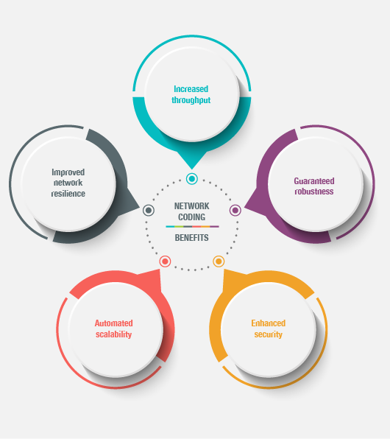
Benefits of Network Coding
Increased Throughput
Guaranteed Robustness
Enhanced Security
Automated Scalability
Improved Network Resilience

Slide 16
BCH Codes
Mervin Chew Fang Yi 202169990116

Slide 17
Stands for (Bose-Chaudhuri-Hocquenghem)
What Are BCH Codes??
Detect and correct errors during data transmission or storage
Used in digital communication and data storage systems

Slide 18
How Does It Work?
Block-Based Encoding
Generator Polynomial
Encoding Process
Syndrome Calculation
Error Correction Capability

Slide 19

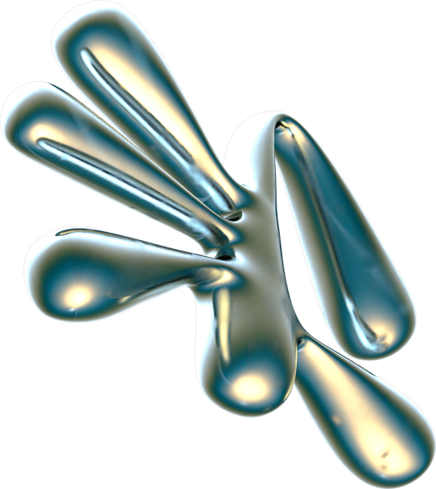
Applications
Trades-off
Digital Storage Media
QR Codes
Wireless LANs
Satellite and Space Communications
Between error correction capability, overhead, complexity of encoding & decoding algorithms
Selecting the right parameters(error-correcting capability, block length) depends on the specific application's requirements

Slide 20
Fountain Code
Bryan Andres Duan Zeng 202169990266

Slide 21
Fountain Codes, a game changing technology in data transmission.
Imagine a scenario where data packets can get lost or corrupted during transmission
Traditional error correction methods have limitations

Slide 22
Also known as rateless codes, are a type of erasure code
What Are Fountain Codes?
They generate an infinite stream of encoded packets from finite source data
These packets hold the power to reconstruct the original data, even in the face of adversity

Slide 23
Data Division
Randomness
Encoded Packets
Independent Transmission
Data Reconstruction
Efficient Recovery
How it works?

Slide 24


Dealing with Lost Data
One fantastic thing about Fountain Codes is their ability to handle lost data pieces.
If some bits disappear during transmission, don't worry. The receiver keeps collecting the remaining ones until it can rebuild the entire picture.
This flexibility makes Fountain Codes super useful in unreliable situations.

Slide 25





Real-World Uses
Fountain Codes aren't just theories ; They're practical solutions
In streaming, they ensure smooth playback
They make file downloads faster and more reliable
In data storage, they boost reliability and durability.

Slide 26
Turbo Codes
Raynard Farrel 202169990298

Slide 27

What are Turbo Codes ?
A class of high-performance FEC codes developed around 1990–1991
First practical codes to closely approach the maximum channel capacity (Shannon Limit)
Made to achieve reliable information transfer over bandwidth- or latency-constrained communication links

Slide 28


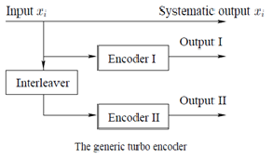

Inner-Workings
Parallel Concatenated Convolutional Codes
Iterative Decoding
Soft-Decision Decoding
Interleavers

Slide 29
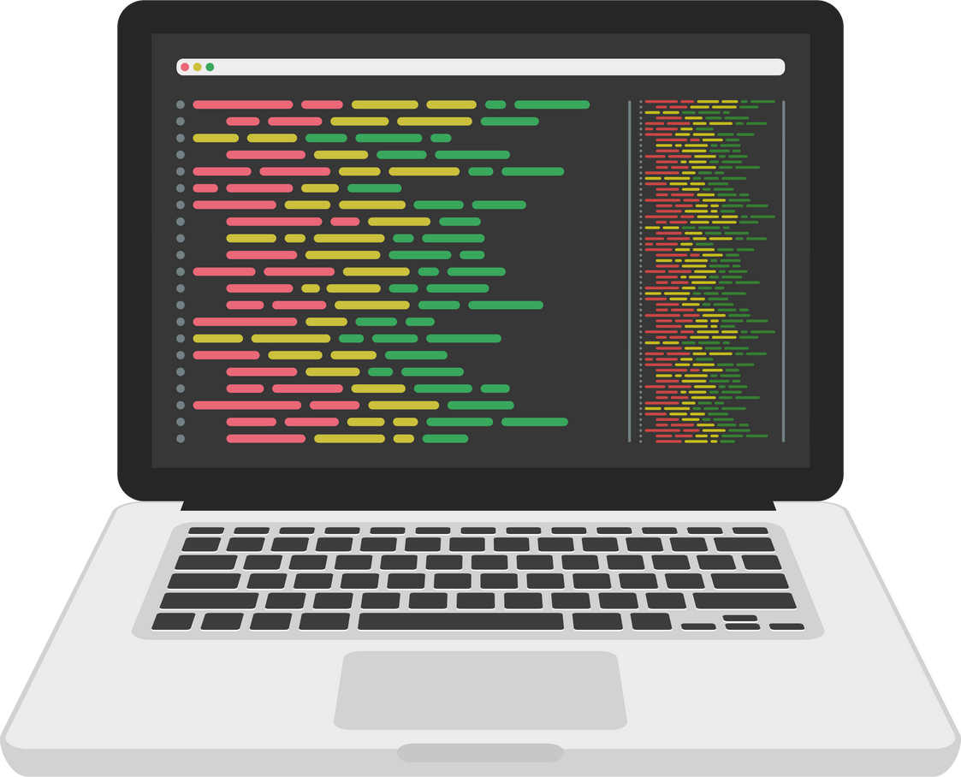
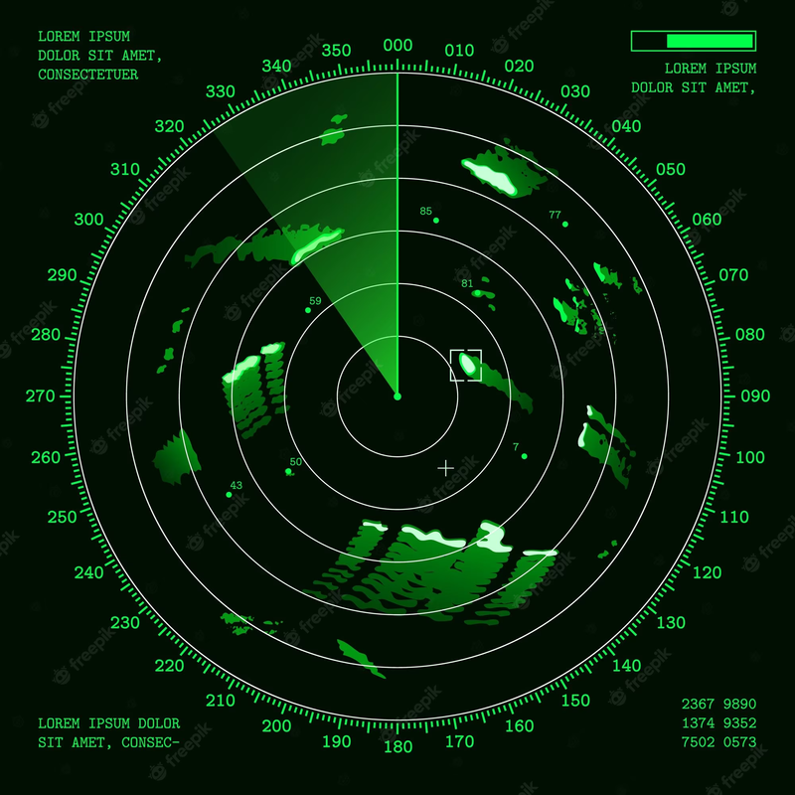
Examples & Applications
Wireless Communication
Wireless LANs
Satellite Communication
Deep-Space Communication
Wireline Communication
Underwater Communication
Data Storage
Digital Television

Slide 30
Conclusion
Kong Siang Yew 202169990243

Slide 31
Conclusion
Error Correction Codes
ESSENTIAL FOR RELIABILITY IN MODERN DIGITAL COMMUNICATIONS |  | USED EXTENSIVELY IN REAL-WORLD SYSTEMS |  | MANY POWERFUL TECHNIQUES EXIST, EACH WITH PROS AND CONS
APPLYING THE RIGHT TECHNIQUE IS KEY TO PERFORMANCE |  | TRADEOFFS EXIST BETWEEN COMPLEXITY, LATENCY, AND CAPABILITY |  | RESEARCH CONTINUES TO IMPROVE CODING EFFICIENCY AND EFFECTIVENESS

Slide 32
Do you have
any questions?
THANK YOU

Slide 33
Besides of LDPC , which code do you think could have the biggest impact on improving wireless communications like 5G?
Q&A

Slide 34
For real-time applications like streaming video or voice calls, which error correction code might work best?
Q&A

Slide 35

Reference
https://en.wikipedia.org/wiki/Reed–Solomon_error_correction
https://www.cs.cmu.edu/~guyb/realworld/reedsolomon/reed_solomon_codes.html
https://en.wikipedia.org/wiki/Linear_network_coding
https://www.techopedia.com/definition/14833/network-coding#:~:text=Network%20coding%20is%20a%20networking,to%20accumulate%20the%20various%20transmissions.
https://www.techslang.com/definition/what-is-network-coding/
https://en.wikipedia.org/wiki/BCH_code
https://en.wikipedia.org/wiki/Fountain_code
https://www.linkedin.com/advice/0/how-do-turbo-codes-improve-reliability-lte-signals-skills-lte#:~:text=Turbo%20codes%20are%20different%20from,the%20performance%20of%20the%20decoder.
https://en.wikipedia.org/wiki/Turbo_code
https://chat.openai.com

